Slide 1

PREDICTING
VEHICLE
DAMAGE EXTENT
IN CAR CRASHES
By: Ryan Ghimire & Aniketh Luchmapurkar

Slide 2
TABLE OF CONTENTS
01
02
03
04
05
06
Project Statement
Description
Preprocessing
Attribute Selection
Training
and Analysis
Conclusion
and Reproducibility

Slide 3

01
PROJECT STATEMENT

Slide 4
GOAL
Predicting vehicle damage severity from traffic collision data

Slide 5

REAL-WORLD APPLICATIONS
Helping police prioritize severe accidents
Identifying accident-prone areas
Improving road and traffic safety

Slide 6
02
DATASET DESCRIPTION

Slide 7
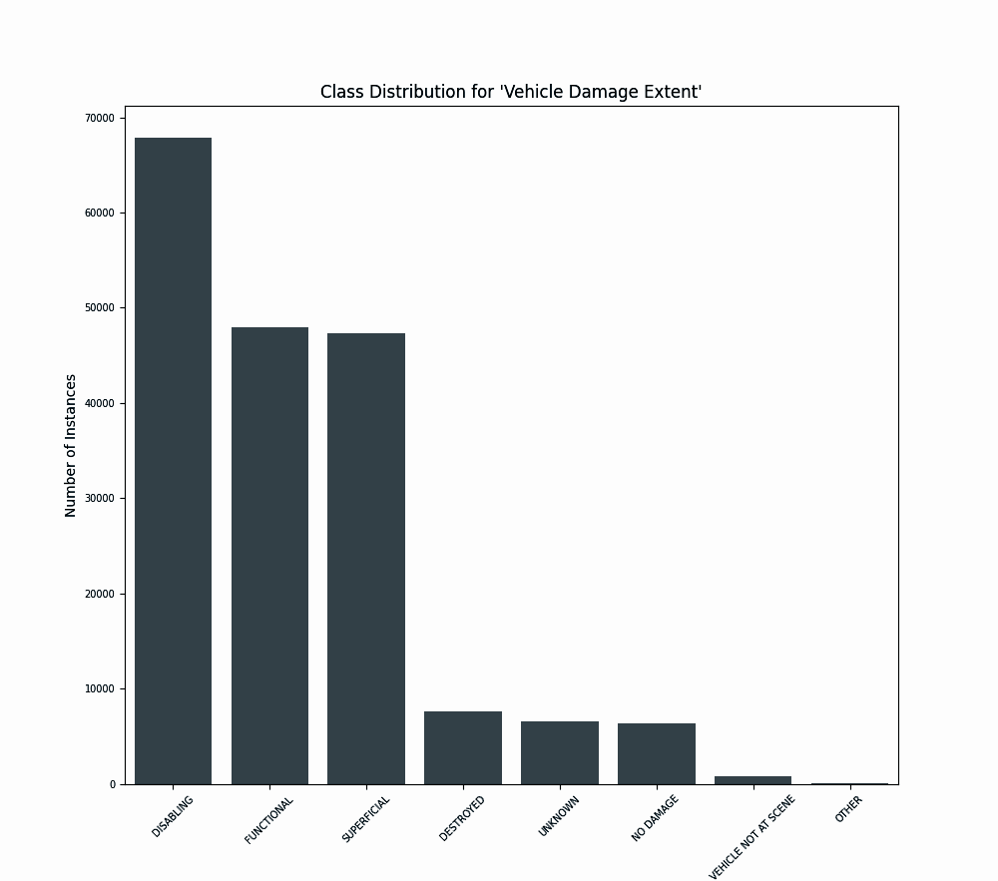
DATASET
Source: Montgomery County Police Department (Crash Reporting Data)
Size: 184,898 instances, 38 features, 1 class attribute
Class Attribute: Vehicle Damage Extent
Labels: Superficial, Functional, Disabling, Destroyed, No Damage
Skewness: 0.826, skewed towards right

Slide 8
Attribute | Number of Missing Values
Report Number | 184897
Local Case Number | 184829
Agency Name | 0
ACRS Report Type | 0
Crash Date/Time | 184897
Route Type | 18161
Road Name | 19364
Cross-Street Name | 28452
Off-Road Description | 178336
Municipality | 165771
Related Non-Motorist | 179002
Collision Type | 1388
Weather | 14133
Surface Condition | 21848
Attribute | Number of Missing Values
Traffic Control | 26879
Driver Substance Abuse | 44756
Non-Motorist Substance Abuse | 180420
Person ID | 158038
Driver At Fault | 4686
Injury Severity | 789
Circumstance | 165594
Driver Distracted By | 36683
Drivers License State | 11432
Vehicle ID | 158050
Vehicle First Impact Location | 3238
Vehicle Body Type | 9139
Light | 3826
Vehicle Movement | 4133

Slide 9
03
PREPROCESSING

Slide 10



PREPROCESSING
Cleaned up dataset (“\n”, “ ‘ “, etc)
Removed attributes (before attribute selection)
IDs, agency names
Derivable attributes like crash date/time, location
Removed missing values
Blank data, other, N/A, unknown, vehicle not at scene
Label encoding
Z-score normalization

Slide 11
04
ATTRIBUTE
SELECTION

Slide 12
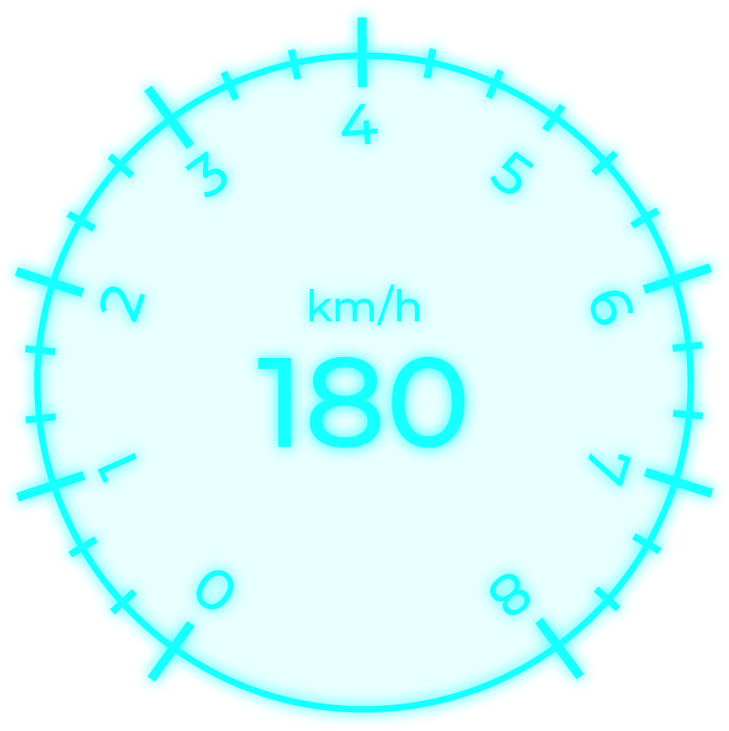
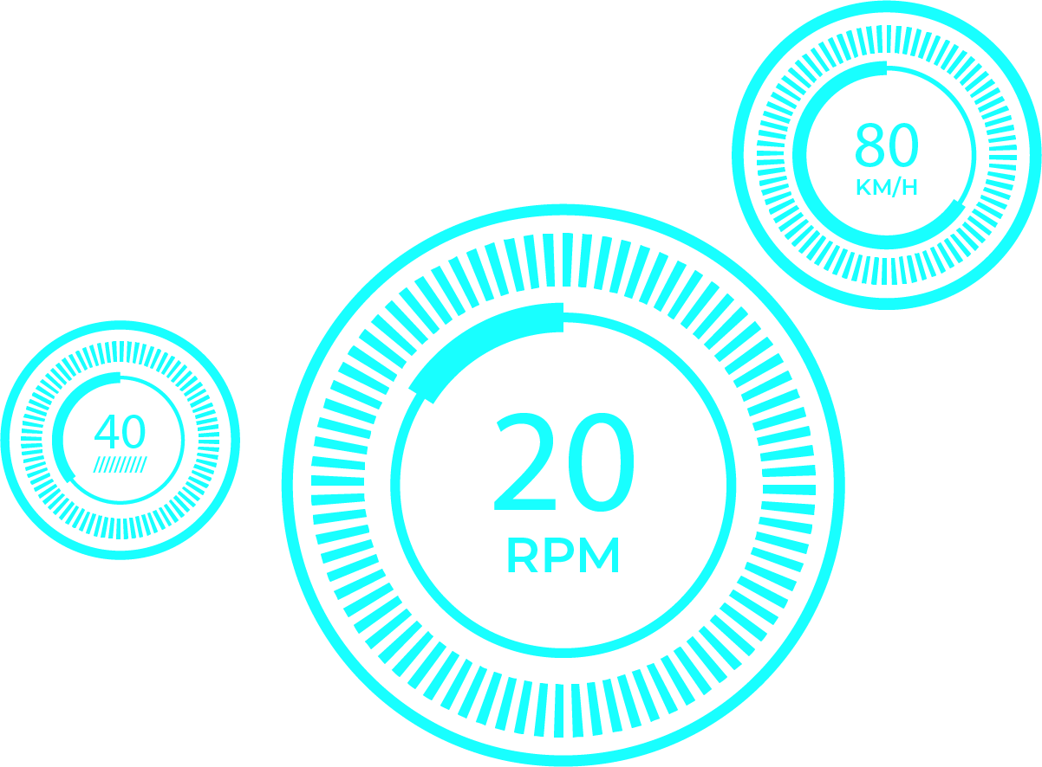
ATTRIBUTE SELECTION METHODS
Non-Weka Manual Analysis
Removed “Driverless Vehicle” due to no data
Information Gain
Used entropy to measure attribute importance
Cutoff: 0.008
Gain Ratio
Adjusted Information Gain for bias
Cutoff: 0.005
Correlation
Measured pearson correlation with class label
Cutoff: 0.0255
CFS (Correlation-Based Feature Selection)
Selected features with high class correlation but low inter-feature correlation

Slide 13
05
TRAINING
AND ANALYSIS

Slide 14
CLASSIFICATION METHODS
J48 (Decision Tree)
Good for qualitative or discrete data
Decision Table
Handles non-linear relationships well
Random Forest
Good with high-dimensional data and different data types
Naïve Bayes
Simple, fast, good for independent attributes

Slide 15
MODEL ACCURACIES
Attribute Selection
 | Non-Weka | Info Gain | Gain Ratio | Correlation | CFS
J48 | 44.9063% | 44.4403% | 47.2168% | 45.7673% | 46.3451%
Decision Table | 51.8493% | 51.8493% | 51.8493% | 50.2315% | 51.6947%
Naive-Bayes | 43.4918% | 43.4792% | 44.417% | 44.2477% | 46.1369%
Random Forest | 53.616% | 53.5926% | 53.4486% | 50.3745% | 48.8958%
Model

Slide 16
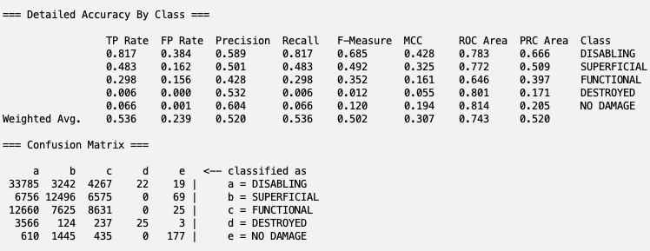

Slide 17
06
CONCLUSION

Slide 18
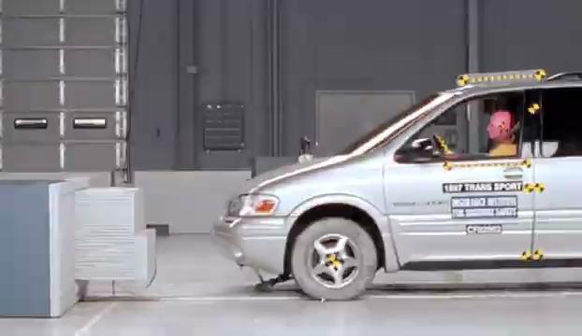

CONCLUSION
Low accuracies attributed to multiple factors
Make and model have significant impact
Not represented well in dataset
Minor changes in angle and speed make major differences
Subjective labels
Functioning vs superficial
Skewed towards disabling label
High amount of missing values

Slide 19
IMPROVEMENTS
PCA
Assumes linear relationship between variables
Balancing class labels
SMOTE
In the future we will:
Obtaining better data
More varied
More detailed
Less missing values

Slide 20
REPRODUCING OUR MODEL
1st
2nd
3rd
4th
Download trainMerged_ND.csv
Open Weka load downloaded file
Run Random Forest classifier
View results in classifier output window

Slide 21
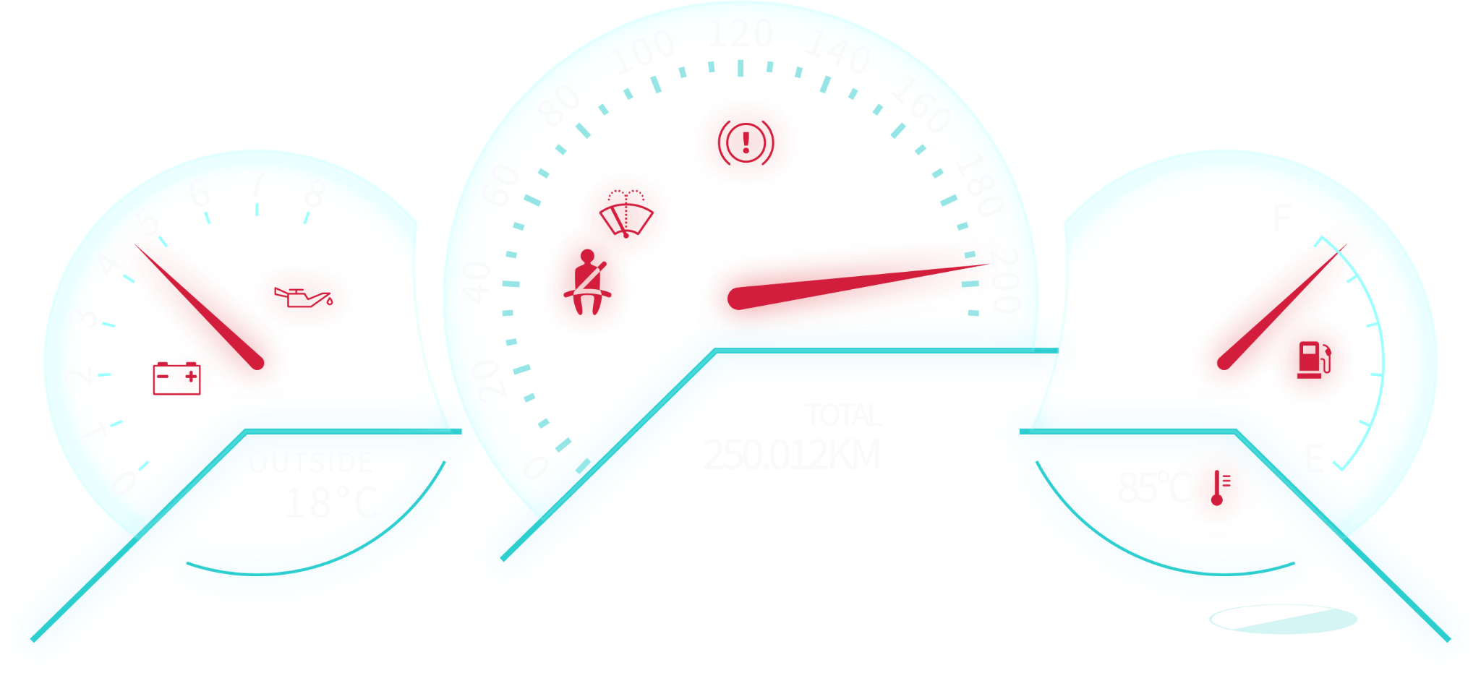
THANK YOU!
ANY QUESTIONS?

